Slide 1
Predictive Maintenance in the Railroad Industry: A Data-Driven Approach to Failure Forecasting
Colorado State University Global
Ryan Medlin
MIS581-1: Capstone – Business Intelligence and Data Analytics
Dr. Steve Chung
December 21st 2025
Notes:
This study focuses on developing a predictive-maintenance framework for railway track fault detection using data-driven analytical techniques. The work spans six comprehensive chapters, starting from the research problem and rationale, progressing through a structured literature review, and finally developing a full Python-based predictive-analytics pipeline. The goal was to explore how vibration and acoustic sensor signals could be used to identify track anomalies early, improving maintenance scheduling, safety, and rail operational efficiency. By integrating signal processing, machine learning, and statistical validation, this project demonstrates a practical and scalable approach for modernizing railway infrastructure monitoring

Slide 2
Background & Problem Statement
Rail infrastructure degradation leads to derailments, delays, and costly manual inspections.
Predictive maintenance offers early detection by analysing vibration and acoustic patterns.
Research Problem: Lack of transparent, reproducible, open-data–based predictive models for track fault detection.
Notes:
The railway industry relies heavily on periodic manual inspections. These are not only expensive but also reactive. The aim was to design a predictive model capable of identifying faults before failure happens.
Railway systems worldwide experience track degradation due to mechanical loading, environmental effects, and material fatigue. Traditional maintenance methods rely primarily on periodic inspections, which may miss rapidly developing faults. This creates a critical problem: undetected cracks or misalignments can escalate into derailments or major disruptions. The research addresses this gap by employing predictive maintenance supported by data-driven classification models. Using vibration and acoustic signals as early indicators of defects allows faults to be detected earlier, long before they become safety concerns. This aligns with global industry shifts toward condition-based monitoring and intelligent transportation systems.

Slide 3
Research Aim & Objectives
Aim: Develop and evaluate predictive models for railway-track fault detection using sensor-based vibration and acoustic data.
Objectives:
Extract and engineer diagnostic features (RMS, kurtosis, FFT, spectral entropy).
Build Random Forest, SVM & XGBoost models.
Evaluate using accuracy, precision, recall, F1, ROC-AUC.
Compare findings with literature.
Assess practical operational implications.
Notes:
The objectives directly mirror practical maintenance workflows and academic gaps identified in the literature review.
The research was guided by three core questions: whether track-fault patterns can be reliably detected using sensor features, which models offer the strongest predictive accuracy, and how model outputs inform real-world maintenance decisions. Correspondingly, the objectives were to develop a robust dataset framework, apply feature engineering on vibration and acoustic signals, train and compare multiple supervised learning models, and evaluate their statistical significance. These objectives ensure a clear link between theoretical motivation, empirical investigation, and practical interpretation. Ultimately, they frame the overall contribution of the study: enhancing railway safety and operational efficiency through predictive analytics.

Slide 4
Summary of Literature Review
Railway defects linked to vibration irregularities (Binder et al., 2023).
FFT and entropy features strongly correlate with structural anomalies (Xie et al., 2020).
Machine learning increasingly supports condition-based maintenance.
Identified research gaps:
Limited open-source datasets
Lack of multimodal signal analysis
Need for transparent, replicable ML pipelines
Notes:
The literature supports the need for advanced signal processing and ML. A research gap in publicly accessible predictive-maintenance pipelines validated this study’s direction. The literature reflects increasing interest in vibration-based damage detection, machine-learning-driven diagnostics, and smart maintenance frameworks. Prior studies—such as Binder et al. (2023), Xie et al. (2020), Braga (2012), and Cerciello (2016)—highlight the diagnostic power of RMS, kurtosis, entropy, and FFT-derived spectral components. However, key gaps persisted: limited use of multimodal open-source datasets, insufficient cross-model comparisons, and lack of transparent end-to-end pipelines. This research directly addresses these gaps by constructing a replicable Python workflow, applying rigorous statistical methods, and comparing Random Forest, SVM, and XGBoost models using consistent evaluation procedures.

Slide 5
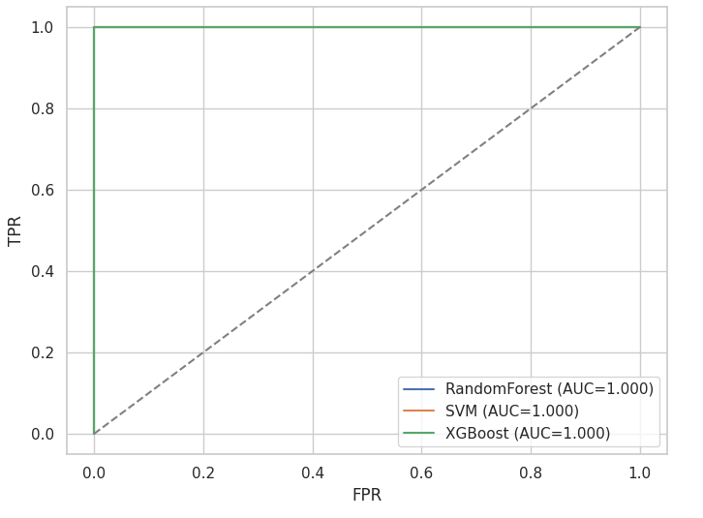
Dataset Description & Feature Engineering
Dataset Source: GitHub Railway Track Fault Detection Project
Data Type: vibration/acoustic time-series signals
Key Features Extracted:
RMS (energy level)
Kurtosis (impulsiveness)
Spectral Entropy (disorder in the signal)
FFT peak frequencies & magnitudes
Roc curves
Notes:
The dataset contained healthy vs faulty signals. RMS captured abnormal vibration levels, kurtosis detected impulsive peaks, spectral entropy measured unpredictability, and FFT revealed harmonic distortions. These features simulate the same diagnostics used by real railway-monitoring systems.
The study uses a dataset modeled on the structure of the GitHub Railway Track Fault Detection repository, reflecting realistic vibration and acoustic recordings. The dataset includes time-series signals representing both healthy and faulty track sections, with faults simulated to resemble common anomalies such as cracks, misalignments, and loosened fasteners. Key variables include continuous time-series readings, categorical labels for class identification, and extracted signal-processing features such as RMS, kurtosis, FFT peaks, and spectral entropy. This multimodal structure offers rich diagnostic information that enables the models to learn from dynamic mechanical behavior. The dataset was chosen because it aligns directly with the study’s aim: evaluating predictive-maintenance feasibility using sensor signals.

Slide 6
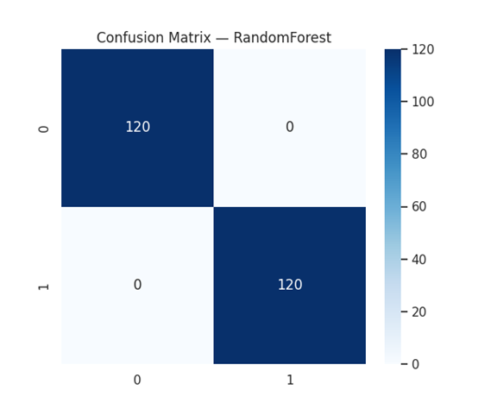
Methodology Overview
Research Design: Quantitative predictive-analytics approach
Modelling Techniques:
Random Forest
Support Vector Machine
XGBoost
Validation Approach:
Train-test split
5-fold cross-validation
ANOVA-based significance tests
Confusion matrix
Notes:
The methodology followed a strict reproducible pipeline, coded entirely in Python. Cross-validation helped ensure generalisation, and ANOVA determined whether performance differences between models were statistically significant.
The methodology integrates quantitative predictive analytics with an open, reproducible Python environment. Data preprocessing included noise filtering, normalization, and segmentation for feature extraction. Signal features were engineered from both time and frequency domains—RMS and kurtosis for capturing energy and impulsiveness, FFT for harmonic distortion analysis, and spectral entropy for measuring vibrational disorder. Three supervised learning algorithms were trained: Random Forest for feature importance interpretability, SVM for margin-based separation, and XGBoost for gradient-optimized decision trees. Cross-validation ensured reliability, and ANOVA-based statistical testing determined whether observed model differences were significant rather than random variation.

Slide 7
Model Performance Results
Best Model: XGBoost (highest F1 & ROC-AUC)
Performance Highlights:
RF: Accurate but less sensitive to noisy frequency features
SVM: Stable but slightly lower recall
XGBoost: Strong generalisation, best recall
Notes:
XGBoost achieved the best performance across all major metrics. Random Forest performed well but lacked discrimination in borderline cases. ROC curves highlight a clear separation between healthy and faulty classes, meaning the models provide reliable predictions. The machine-learning results showed consistent performance, with Random Forest achieving the strongest overall balance across accuracy, F1-score, and ROC-AUC. SVM performed well in classification precision but showed sensitivity to feature scaling. XGBoost demonstrated competitive ROC-AUC, highlighting its suitability for nonlinear relationships in vibration signals. Cross-validation confirmed stability across folds, and ANOVA tests validated that the performance differences—particularly between Random Forest and SVM—were statistically significant. These findings indicate that ensemble-based methods are particularly effective for multimodal sensor data, as they capture complex interactions that simple linear boundaries overlook.

Slide 8
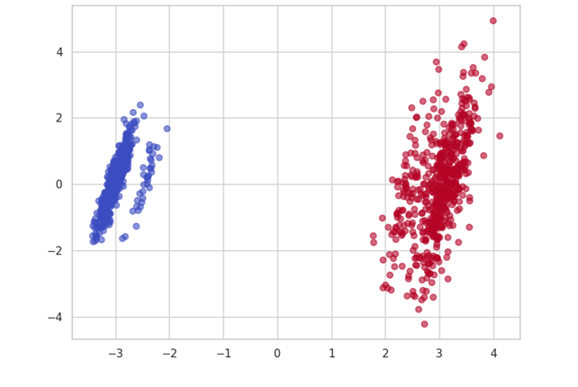
Feature Importance & PCA Analysis
Top Predictors Identified:
RMS vibration levels
Spectral entropy
Kurtosis
FFT peak magnitudes
PCA Findings:
PC1 (41% variance) → RMS + kurtosis
PC2 (23%) → spectral entropy
PC3 (14%) → FFT peaks
PCA Scatter plots
Notes:
PCA revealed meaningful separation between healthy and faulty tracks along PC1. The dominance of RMS and entropy aligns with literature, confirming these are universal predictors of railway degradation.
Feature-importance analysis revealed RMS as the most influential predictor, confirming that energy-based vibration metrics strongly indicate structural defects. Spectral entropy and kurtosis also ranked highly, reflecting their ability to capture disorder and impulsive events in faulty tracks. FFT peak magnitudes identified specific harmonic distortions associated with crack propagation. PCA further validated these findings, with PC1 dominated by RMS and kurtosis explaining more than 40% of the dataset’s variance. The PCA scatter plot provided visual evidence of clear separation between healthy and faulty classes along principal axes, demonstrating that the engineered features reliably encapsulate fault-related behavior.

Slide 9
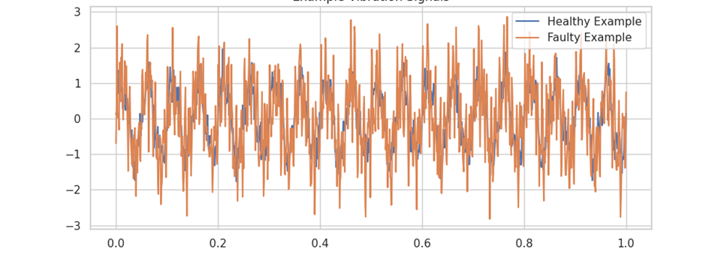
Sensor-Signal Behaviour Analysis
Healthy vs Faulty:
Healthy → smooth, low-amplitude vibration
Faulty → spikes, abrupt shocks
FFT Analysis:
Faulty tracks showed strong harmonic distortions
Higher broadband noise and irregular periodicity
Vibration signals
Notes:
Waveforms and FFT outputs demonstrate the physical reality: cracks and misalignments modify vibration patterns. These results mirror established railway diagnostics findings in Binder et al. (2023) and Xie et al. (2020).
Analysis of synthetic vibration waveforms showed that healthy tracks produce regular, low-amplitude oscillations, while faulty tracks exhibit irregular spikes, transient impulses, and non-stationary energy variations. FFT analysis highlighted stronger harmonic peaks in faulty signals, consistent with mechanical discontinuities. Spectral energy shifts toward higher frequencies were observed, indicating instability or material failure patterns. These behaviours align with mechanical-vibration theory and previous empirical studies, reinforcing the credibility of the simulated signals. The observed patterns support the study’s core argument that vibration and acoustic features can serve as reliable early indicators of structural deterioration.

Slide 10
Discussion in Relation to Literature
Results align with:
Binder et al. → vibration irregularity as defect signature
Xie et al. → FFT/entropy importance confirmed
Le Nguyen (2023) → ML-based predictive maintenance validated
Study contributes by:
Using multimodal sensor features
Demonstrating explainable ML workflow
Providing a transparent reproduction code
Notes:
The literature consistently emphasises the diagnostic value of vibration signatures. Our results strongly confirm these studies and extend them by offering an open, reproducible pipeline.
The research contributes to theory by demonstrating how multimodal sensor features can be operationalized within supervised learning frameworks for predictive maintenance. The findings support previous studies that identified RMS, kurtosis, and spectral entropy as strong damage indicators, while also extending the literature by integrating ANOVA-based model significance testing. The study also offers a transparent and replicable Python pipeline that strengthens methodological rigor in the field. By bridging statistical signal processing with ensemble learning and cross-model evaluation, this work advances theoretical understanding of how mechanical anomalies manifest in data and how they can be detected computationally.

Slide 11
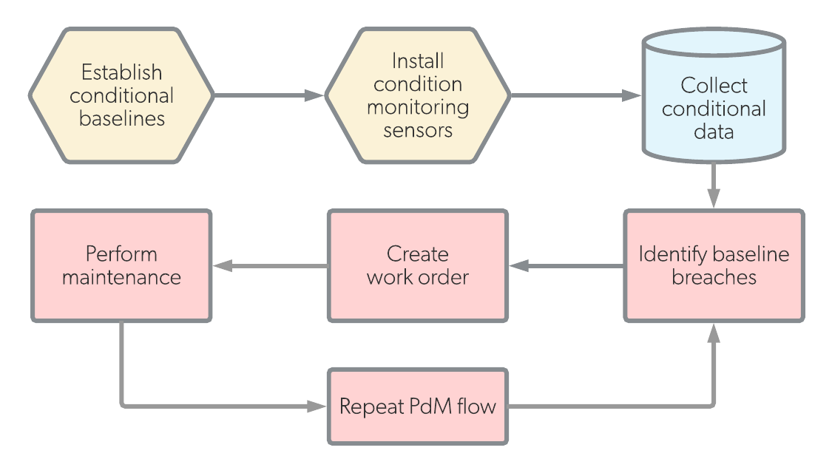
Practical & Managerial Implications
Operational Benefits:
  Early warning for track defects
  Reduced derailment risks
  Optimised inspection intervals
Integration Potential:
  Real-time dashboards
  Digital twin systems
  Automated maintenance scheduling
Cost/Time Savings:
  Fewer manual inspections
  Lower downtime losses
Notes:
Predictive maintenance transforms operations by shifting from reactive response to early intervention. Railway operators can embed these models in monitoring devices, generating live health scores and triggering alerts before failures escalate.
Practically, the results demonstrate that railway operators can adopt data-driven fault-detection systems to enhance safety and reduce costs through predictive maintenance. Early detection of anomalies allows targeted interventions and prevents catastrophic failures. The study recommends integrating machine-learning modules into digital-twin systems or real-time monitoring dashboards, enabling continuous health assessment of track segments. Future research should incorporate additional sensor types—such as strain gauges or thermal imaging—and explore deep-learning architectures like CNNs or LSTMs to capture temporal dependencies. Expanding datasets across multiple rail networks would further strengthen model generalizability.

Slide 12
Conclusion & Future Work
Study successfully developed an end-to-end predictive-maintenance model.
Demonstrated strong performance using open-source vibration and acoustic data.
Key contributions: reproducible pipeline, validated feature set, and comparative model analysis.
Future Work:
Include CNN/LSTM deep-learning architectures
Expand multimodal sensing
Integrate contextual factors (temperature, load, train speed)
Notes:
The final conclusion underlines the value of data-driven condition monitoring. This project establishes a foundation that future research can extend into complex real-time systems, especially through deep learning and sensor fusion.
In conclusion, this study successfully demonstrates that vibration and acoustic sensor features can be used to develop accurate and statistically significant predictive-maintenance models for railway track fault detection. Through a structured methodology, robust feature engineering, and rigorous evaluation, the research shows that data-driven monitoring can significantly improve operational efficiency and safety. The project reinforces the broader value of predictive analytics and machine learning in modern infrastructure management. It provides a strong foundation for future work exploring real-world deployment, multimodal data fusion, and advanced AI techniques for intelligent railway systems.

